Slide 1
GROOV
FINAL PROJECT PRESENTATION

Slide 2


Team 18
Aaditya Nair U2103001
Aathira K U2103004
Abhinand Santosh U2103006
Aldrin Lyju U2103023
Guide:
Dr. Jincy J Fernandez

Slide 3
GROOV
Project Contents
1
Problem Definition
6
Proposed Methods and Modules
2
Purpose and Needs
7
Work Division & Gantt Chart
3
Project Objectives
8
Budget
4
Literature Survey
9
Expected Output
5
Architecture & Sequence Diagram
10
Conclusion
02/30

Slide 4
Problem Definition
Maintaining and acquiring instruments can be costly and time-consuming, creating barriers for musicians seeking a smooth, affordable playing experience. Switching between instruments during a performance can also be cumbersome, disrupting flow and creativity.

Slide 5
Purpose & Need
The purpose of this device is to provide a fun, intuitive way for casual users to explore and create music by mimicking instrument sounds through simple actions.
It addresses the need for an accessible, affordable solution that makes switching between instruments easy, making music-making enjoyable and approachable for everyone.

Slide 6
Project Objective
To create a device that allows beginners and aspiring musicians to learn and explore various instrument affordably and without needing much space, enabling them to express their creativity and develop their skills at home

Slide 7
Literature Survey
Paper
Advantages
Disadvantages
Turcher L; Antoniazzi, F; Viola ,F; Giunchiglia ,F. The Internet of Musical Things Ontology. Journal of Web Semantics, 60(16): 100548, January(2020)
Relies on other ontologies
Not evaluated in real IOMusT settings
Interoperability
Applicable to both IOT and music field
Zhou, Z; Wearables Hapic Feedback System and Interfaces, Highlights in Science Engineering and Technology, Vol. 45, 18-24, April(2023)
Comfort and Flexibility
Enhanced Interaction
Thermal Sensitivity
Integration Complexity

Slide 8
Paper
Advantages
Disadvantages
Xu, P. Research on the Application of Computer Music Software in College Traditional Music Course. Phys: Conf. 2021 022178
Real time feedback
Personalized learning
Software limitation
Cost and Access
Wang,H. Research on the Application of Wireless Wearable Sensing Devices In Interactive Music. Journal of Sensors. Vol.2021,October(2021)
Enhanced Immersion
Multi-sensor Integration
Battery and Energy issues
Latency Issues
Wexler ,D; Yip ,J; Lee, K; Li, X; Wong, Y. Touch on Musical Innovation: Exploring Wearables and Their Impact On New Interfaces for Musical Expression. Sensors 2024, Vol. 24, 250, December(2023)
Increased Interactivity
Cost efficient
Latency issue
Limited responsiveness

Slide 9
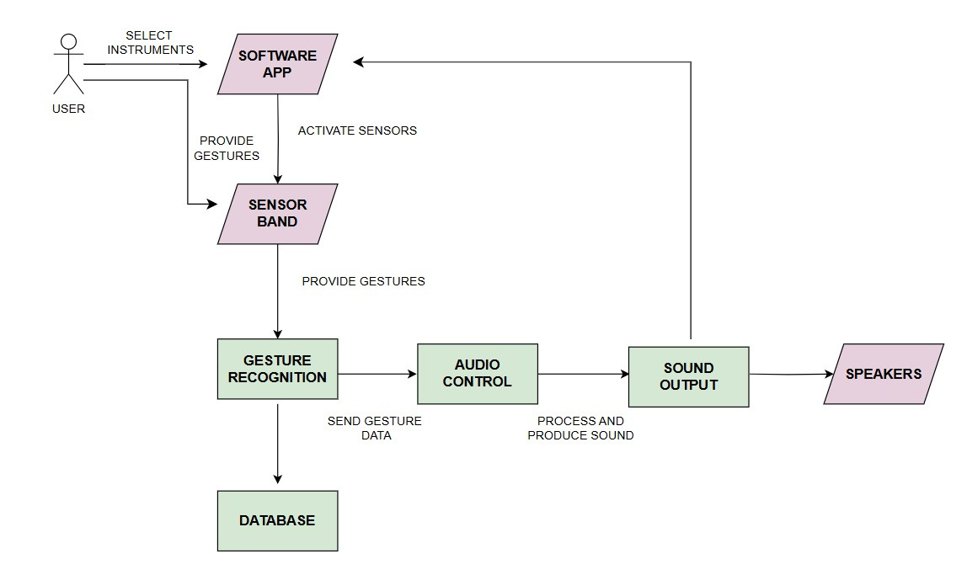
Architecture Diagram

Slide 10
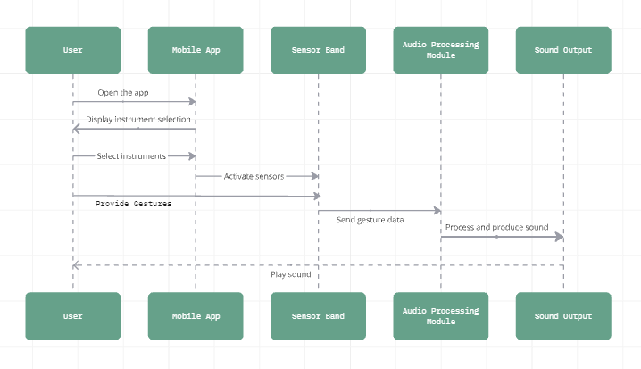
Sequence Diagram

Slide 11
Modules
Hardware: To design and build the physical device to incorporate the sensors.
Gesture Recognition: Utilize IMU’s to detect user movements and translate them into audio.
MIDI Protocol Implementation: To facilitate effective communication between devices
Sound Processing Software: To ensure the production of high quality sound output.
User Calibration: A calibration feature to adjust sensitivity and responsiveness based on individual user preferences and playing styles.

Slide 12
Assumptions
User Engagement: The device is expected to be intuitive and engaging, encouraging interest in music-making.
Gesture Accuracy: Gesture recognition is assumed to reliably interpret user movements for a smooth experience.
Sound Quality: The software is expected to deliver high-quality, realistic instrument sounds.
User Learning Curve: Users are assumed to adapt quickly, with minimal effort required for beginners.

Slide 13
Requirements:
Hardware:
Software:
Xcode : Swift
Arduino ide
seeed studio xiao nrf52840 sense microcontroller
Power supply: lithium polymer battery
Wireless module: bluetooth
Glove/Band : 3D moduled enclosure

Slide 14
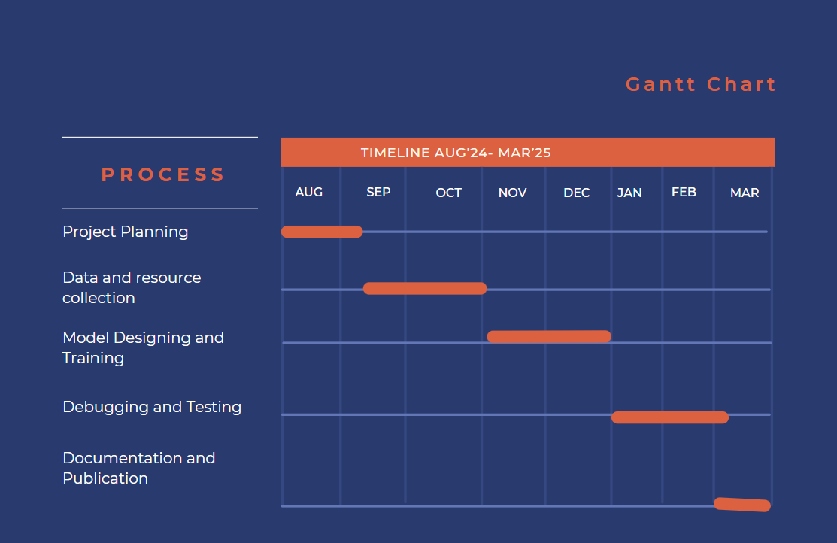
Gantt Chart

Slide 15
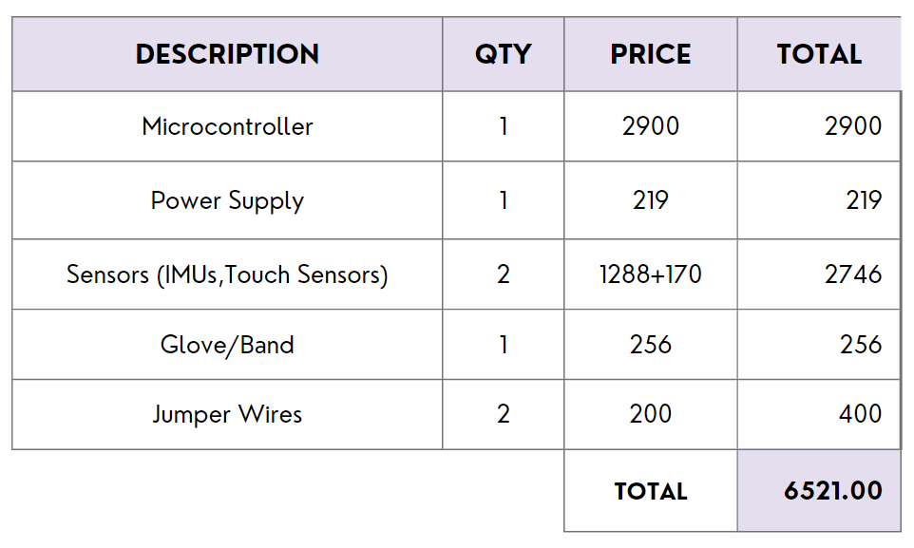
Budget

Slide 16
Risk and Challenges
Gesture Accuracy: Misrecognition could lead to incorrect musical output.
User Adoption: Some users may need guidance to use gesture controls effectively.
Market Adoption: Tech-based instruments may face competition and skepticism.
Cost Management: Balancing quality with affordable production is a challenge.
Hardware Integration: Ensuring accurate IMU-based tracking can be complex.

Slide 17
Expected Output
Instrument Simulation: Users can play multiple instruments (drums, violin, piano) using natural hand gestures with real-time sound feedback.
Minimal Hardware: A lightweight wearable device with sensors, eliminating the need for physical instruments or controllers.
Accurate Gesture Recognition: High precision in tracking gestures for realistic and responsive sound generation.
Mobile/PC App Integration: Wireless control via a user-friendly app for instrument selection and settings adjustment.

Slide 18
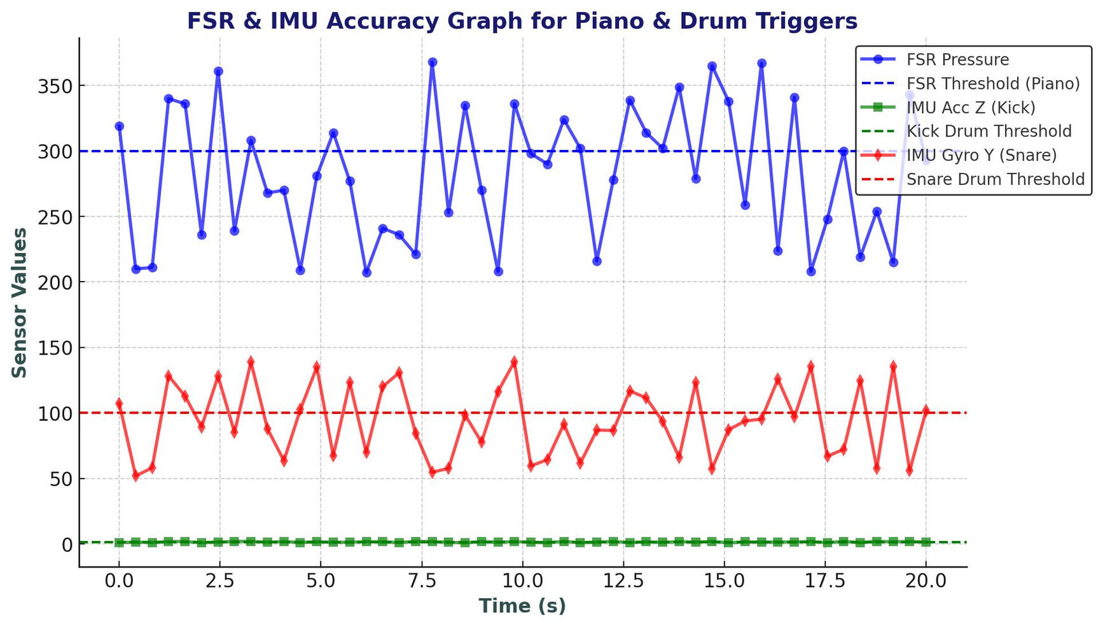
Result

Slide 19
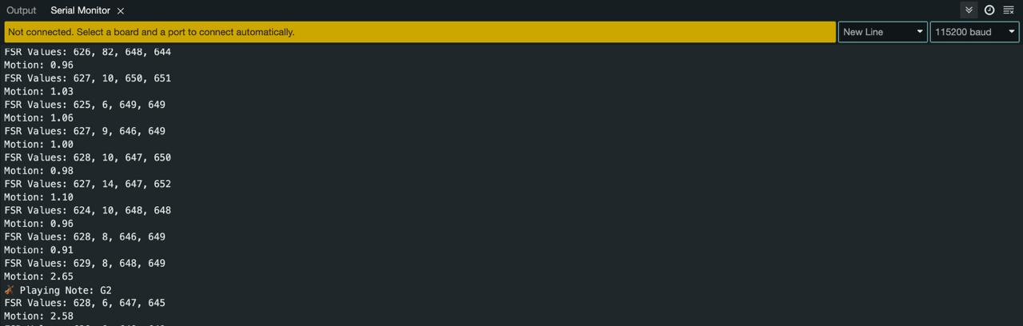
Result

Slide 20
Conclusion
Groov transforms natural hand gestures into dynamic musical expressions, offering musicians an intuitive and portable platform for creativity. Its minimalist design eliminates the need for extensive equipment, enabling artists to compose and perform music seamlessly in diverse settings.

Slide 21
References
1.Wang,H. Research on the Application of Wireless Wearable Sensing Devices In Interactive Music. Journal of Sensors. Vol.2021,October(2021)
2.Wexler ,D; Yip ,J; Lee, K; Li, X; Wong, Y. Touch on Musical Innovation: Exploring Wearables and Their Impact On New Interfaces for Musical Expression. Sensors 2024, Vol. 24, 250, December(2023)
3.Zhou, Z; Wearables Hapic Feedback System and Interfaces, Highlights in Science Engineering and Technology, Vol. 45, 18-24, April(2023)
4.Xu, P. Research on the Application of Computer Music Software in College Traditional Music Course. Phys: Conf. 2021 022178
5. Turcher L; Antoniazzi, F; Viola ,F; Giunchiglia ,F. The Internet of Musical Things Ontology. Journal of Web Semantics, 60(16): 100548, January(2020)

Slide 22
THANK YOU

